Slide 1
Lesson 1.11: Asking questions
Unit 1: Mental Health
Notes:
This lesson focuses on the skill of asking questions. Students often have little practice asking thoughtful questions. But this skill is essential for problem identification and problem-solving. Students will begin the lesson by playing a fun game which will get them in the mode of asking questions. They will then explore the topic of asking questions in the context of three qualities of excellent questions: they are probative, relevant, and rigorous. Through the use of an article (on texting), a TED talk video (on unanswerable questions), and a mystery activity, students will practice identifying and asking excellent questions in an engaging and challenging way.
Image source: http://whatdoclientsreallywant.com/tag/asking-questions/

Slide 2
Do Now: The Question
You must not answer any question.
Take turns asking the questions. You must respond to the other person’s question with a different question.
Never repeat a question.
You must ask your question within 5 seconds of the other person finishing their question.
Make a tally mark for each time you break one of these rules. The winner is the person with the fewest tally marks.
Notes:
The point of this activity is to get students brains “warmed up” in a context that is familiar and easy for most of them (questions dealing with social interactions).

Slide 3
Discuss
What was challenging about that game?
What makes asking questions difficult?
Notes:
Image source: http://www.vapartners.ca/sales-questions-key-to-success/

Slide 4
Why Questions?
Questions are designed to probe, to find something that is not already there, to discover relationships and possibilities that are not given.
-Matthew H. Bowker, “Teaching Students to Ask Questions”
Notes:
This quote was taken from the article found at: http://www.nea.org/assets/img/PubThoughtAndAction/Bowkershort.pdf
The labels of rigorous, relevant, and probative were not a part of the original article but a product of interpretation about this quote.

Slide 5
3 Key Qualities of Excellent Questions
Relevant (“to find something that is not already there”)
Rigorous (“to discover relationships and possibilities that are not given”)
Probative (“to probe”)
Notes:
There are MANY other adjectives that may describe excellent questions equally well. If time, provide students with an opportunity to share other ideas.
Image source: http://www.chicagonow.com/own-your-legacy/2013/05/why-asking-the-tough-questions-isnt-easy/

Slide 6
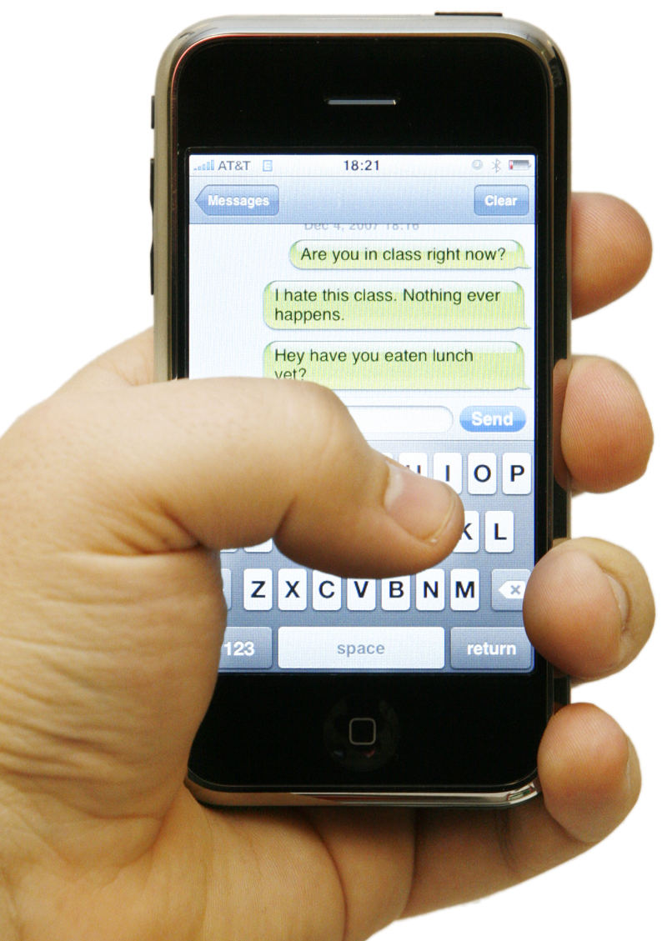
Texting May Be Taking a Toll
They do it late at night when their parents are asleep. They do it in restaurants and while crossing busy streets. They do it in the classroom with their hands behind their back. They do it so much their thumbs hurt.
Spurred by the unlimited texting plans offered by many carriers, American teenagers sent and received an average of 2,272 text messages per month 2008 — almost 80 messages a day, more than double the average of a year earlier. The phenomenon is beginning to worry physicians and psychologists, who say it is leading to anxiety, distraction in school, falling grades, repetitive stress injury and sleep deprivation.
Source: NYTimes, 5/26/09
Notes:
This article excerpt is slightly dated (given the quick explosion in popularity of texting in the past 5-10 years), which hopefully students will point out. This excerpt makes no mention of texting and driving (a huge health concern in our present time), so encourage them to make these broader connections a part of their questions.
Image source: http://www.theschoolphilly.com/2012/08/13/2012-ladies-and-gents-texting-thumb-is-now-a-disease/

Slide 7
Fill in the table with info from the article:

Slide 8
Excellent Questions are RELEVENT
Write 3 questions that you would ask to “find something that is not already there.”
Share your questions in a small group.
Vote on the question that seems most relevant for each person.
Extra time? …Discuss what other qualities make questions excellent.

Slide 9
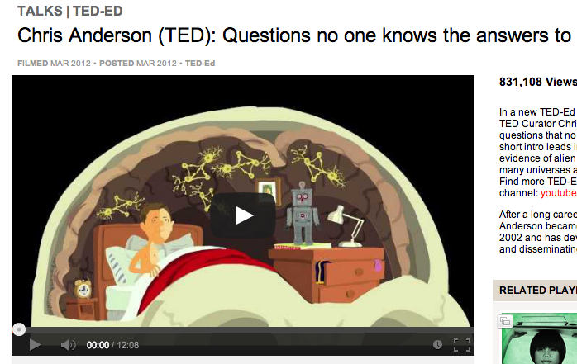
Excellent Questions are RIGOROUS
Watch the TED Talk by Chris Anderson called: “Questions No One Knows the Answers To.”
As you watch, jot down the interesting questions you hear
http://www.ted.com/talks/questions_no_one_knows_the_answers_to.html
Notes:
The engaging animated talk is 12 minutes long and provides a way to extend the importance of asking questions to a realm that may seem more significant and important to students. It’s takeaways may not be directly relevant to getting students to develop rigorous, relevant, and probative questions that can be used in their case studies, but it WILL spark their curiosity and hopefully help them discover that questions are interesting and fun.

Slide 10
What might a RIGOROUS question look like?
Examples:
What is different about the average diet of an obese child and a child of healthy weight?
Do antidepressants change the likelihood of person having suicidal impulses?
What are teenagers perceptions of e-cigarettes?
Non-examples:
Do obese kids eat too much?
What causes suicide?
Why are e-cigarettes popular?
http://www.ted.com/talks/questions_no_one_knows_the_answers_to.html
Notes:
The examples and non-examples are not inherently good or bad. There can be some discussion and debate. The big idea is to think about rigor as being more specific and thoughtful. A broad question like “What causes suicide?” cannot be answered with one specific thing, but asking about how one particular factor impacts suicide is definitely answerable and worth exploring.

Slide 11
Discuss:
What is the difference between a rigorous question and one that is not?
Do you agree with the lists above demonstrating examples and non-examples of rigorous questions. Why or why not?

Slide 12
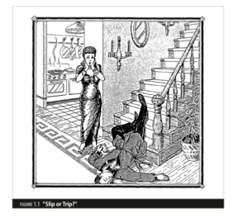
Slip or Trip?
Examine the scene.
Write 3-5 questions you want answered to solve this mystery.
Was this murder or an accident?
Notes:
It may drive students crazy, but they will NOT learn the answer to the mystery. The frustration that this might produce is a good demonstration of how questions sometimes seem to DEMAND answers of us. If they can feel the same gravity in the questions they ask about health issues they tackle in case studies, they will be in a great place to solve big problems.
Image source: http://www.theschoolphilly.com/2012/08/13/2012-ladies-and-gents-texting-thumb-is-now-a-disease/

Slide 13
Excellent Questions are PROBATIVE
The definition of probative is: “having the quality or function of proving or demonstrating something; affording proof or evidence.”
Discuss your questions with a partner. Which questions are the most probative? What makes them probative?

Slide 14
Homework:
Use the following topics to write a rigorous, relevant, and probative question:
Increase in diabetes
Correct use of asthma inhaler
Addiction to cigarettes
Sports injuries
Notes:
The goal of this homework is to give students some practice asking questions in the context of health issues similar to ones they will tackle in future case studies. There are not wrong or right answers, just varying degrees of the quality of questions (based on their being probative, relevant, and rigorous).

